Slide 1
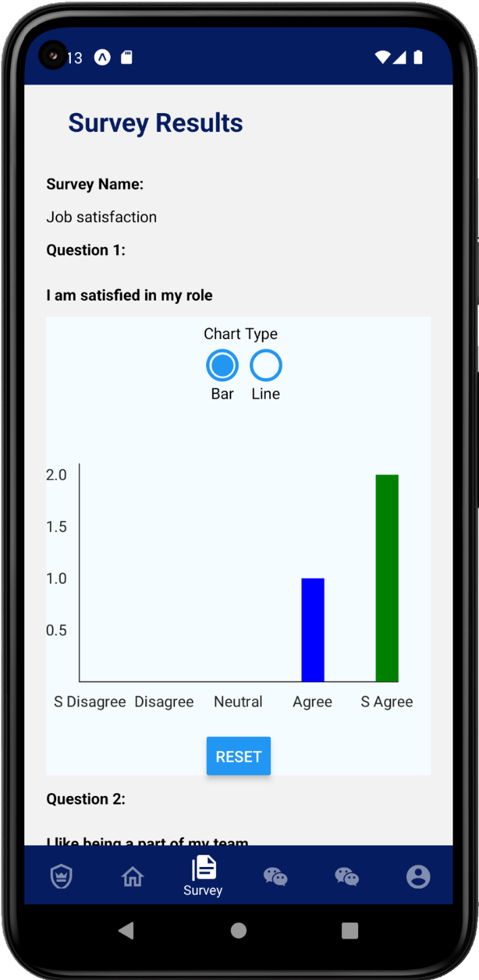
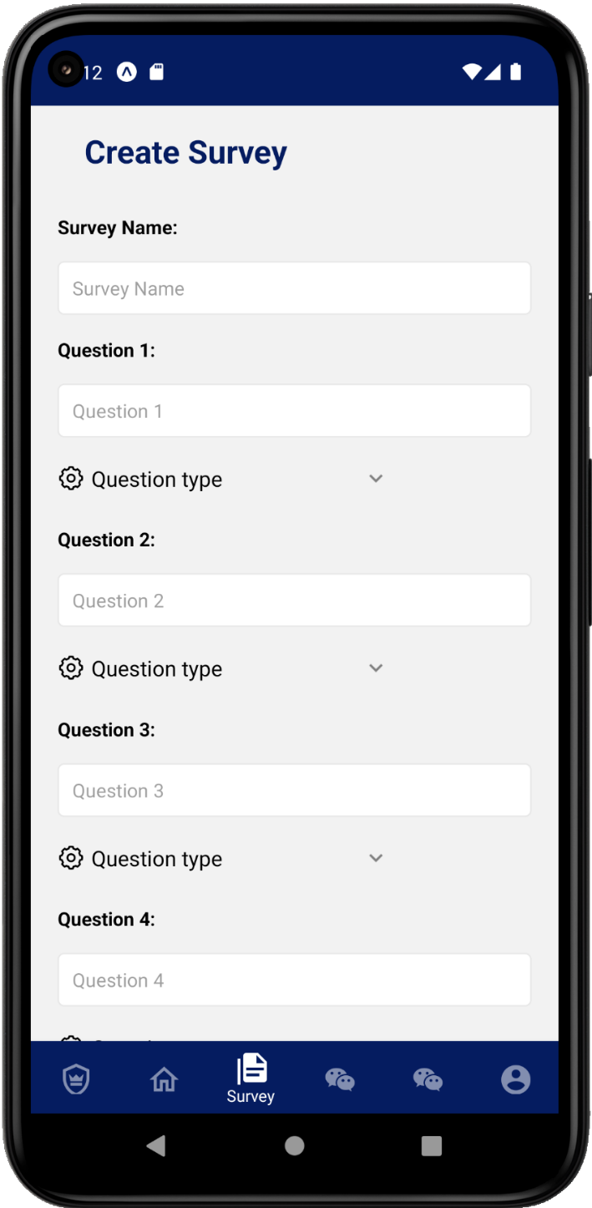
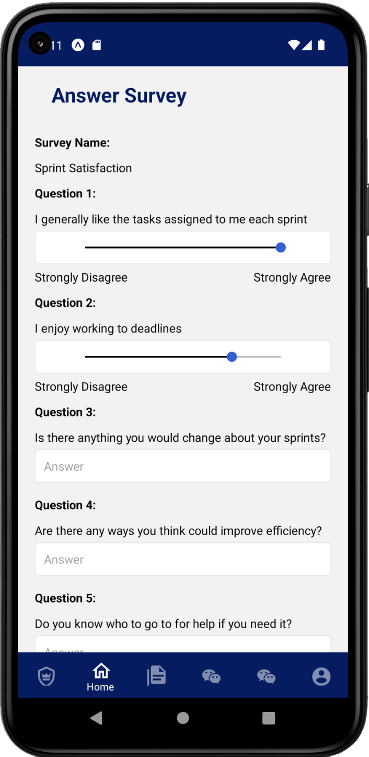
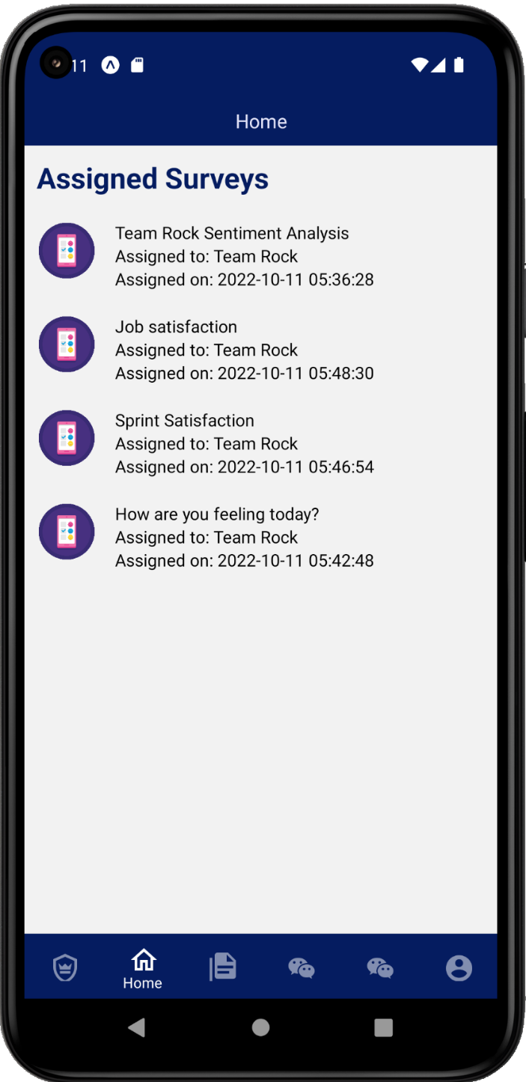
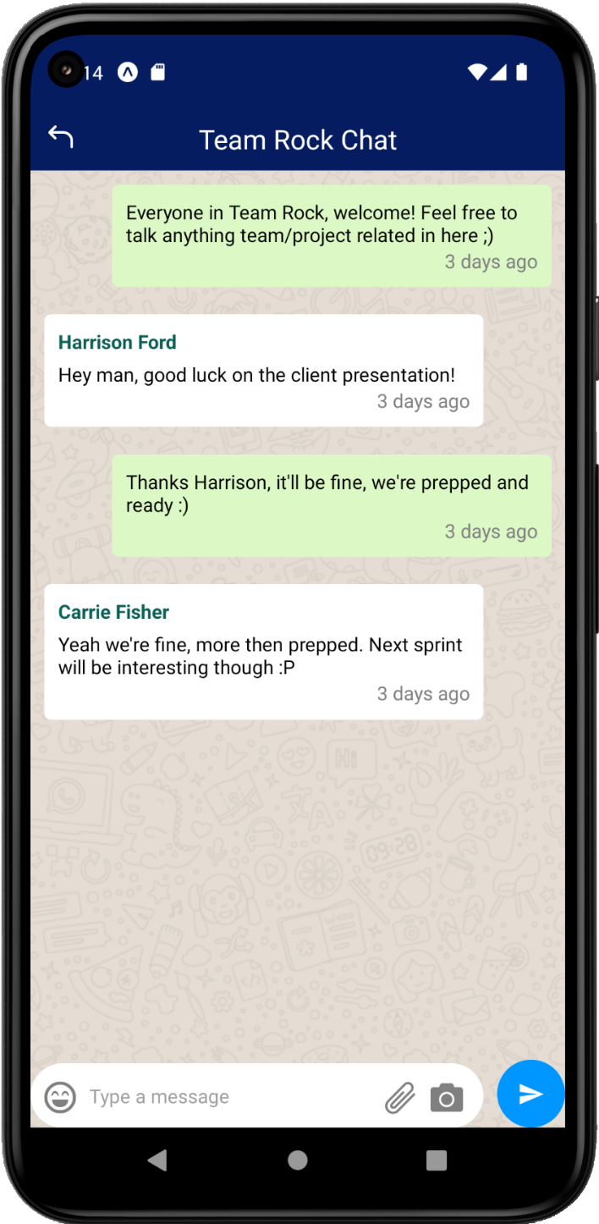
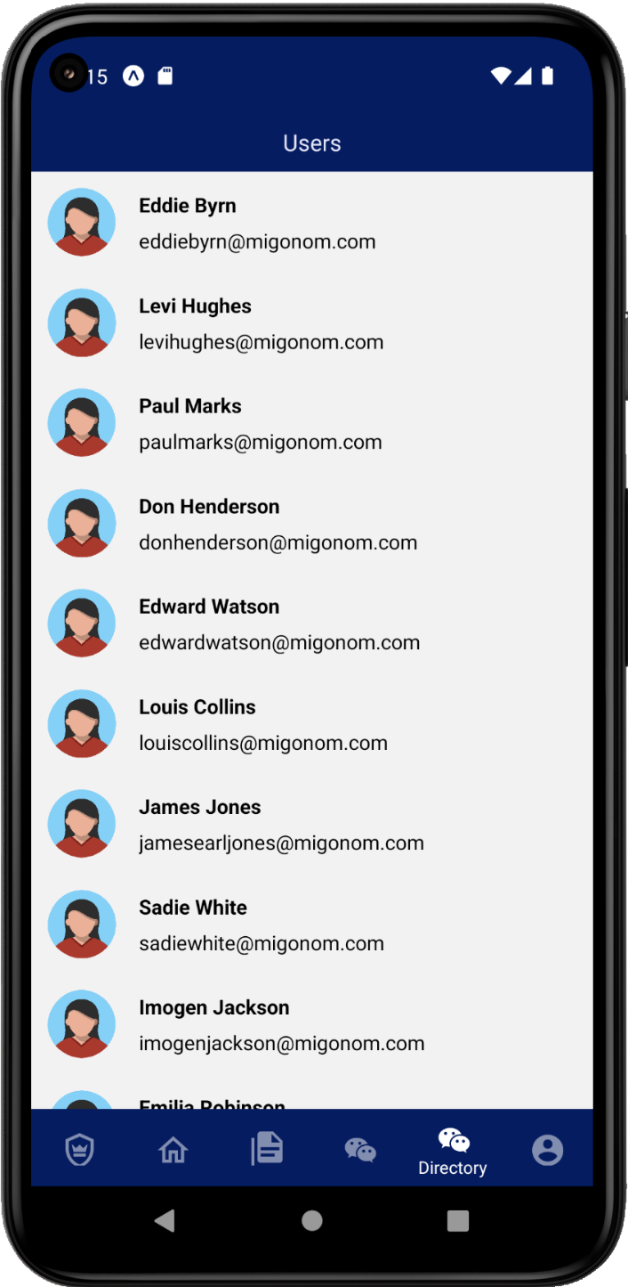
Staff Engagement Visualisation Experience
By Team Freeware

Slide 2


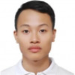



Team Freeware Re-Introduction
Alex McCoy
Duc Hung Tran
Ali Alriyami
Hamza Shaikh
James Worcester

Slide 3
Presentation Purpose
Why?
To demonstrate the project in its final state as this is our last presentation
How?
Analysing and showing user stories from our recent sprints
Presenting a structural view of the problem domain through detailed documentation and diagrams
Opening to questions and feedback
Presenting a system overview
Showcasing our sprint plan, sprint backlog and implementation
Explain the final system architecture
Demonstrate usability testing plan and results
Presenting the final prototype

Slide 4

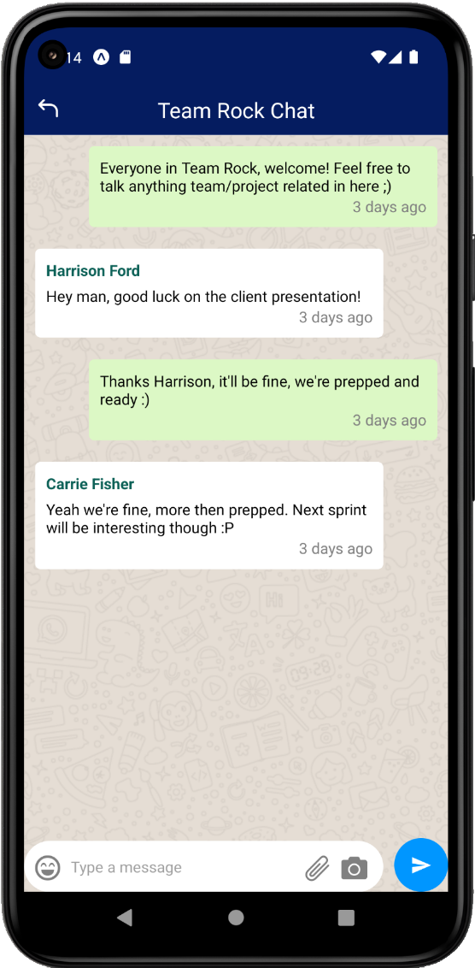
Current System Overview
Authentication
Dashboard/Navigation
Chat Channels
Survey Functionality
User Directory
Teams
Profile

Slide 5











System Architecture
Scalable Serverless Backend
APIs & Connectivity
Client-Side
React Native
Cross-Platform iOS & Android App
Amazon RDS
Presentation Layer
Logic Layer
Data Layer

Slide 6
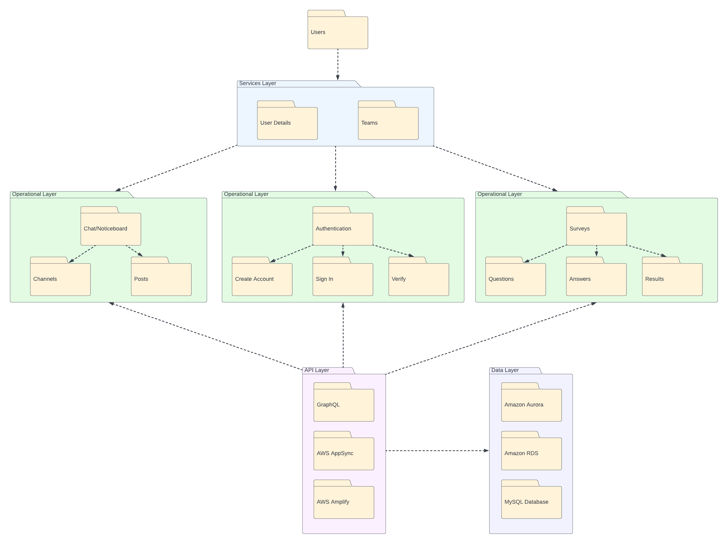
Package Diagram
Data Layer

Slide 7
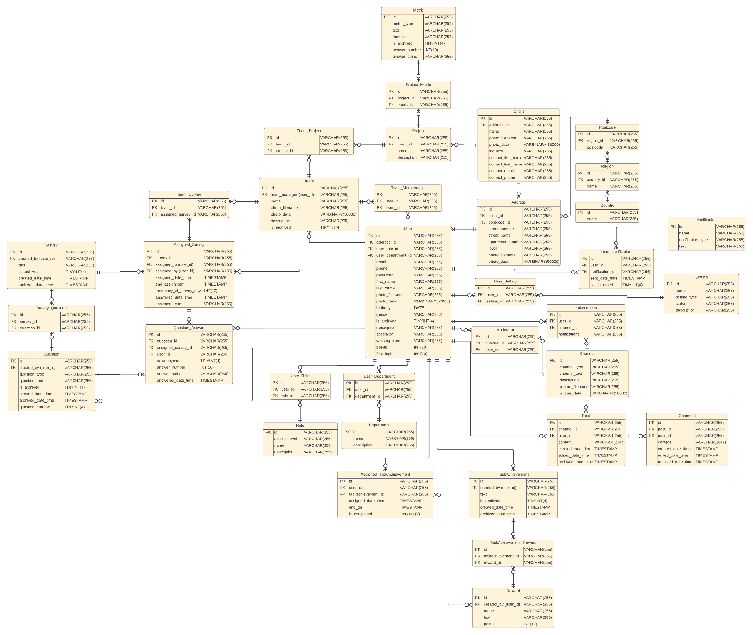
Entity Relationship Diagram
Data Layer

Slide 8
Demonstration

Slide 9
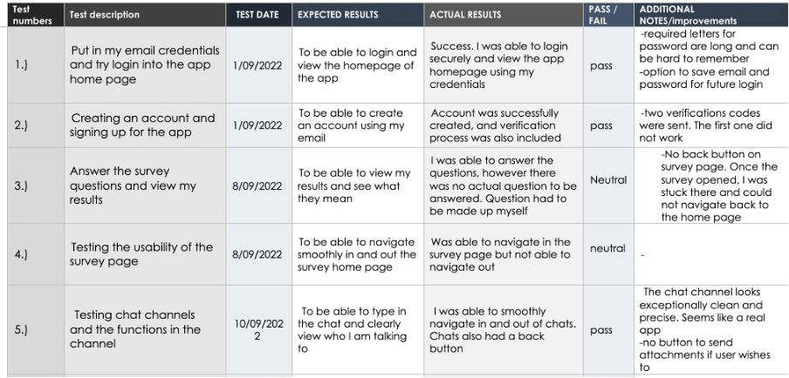
Usability Test Plan

Slide 10
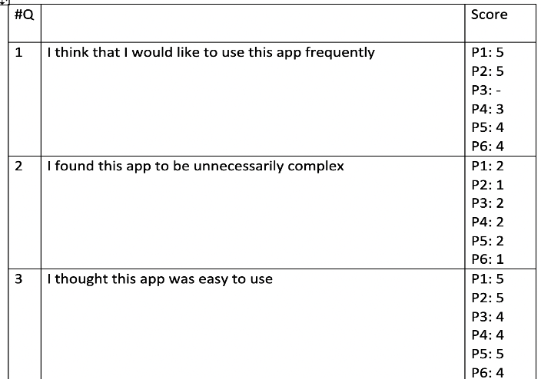
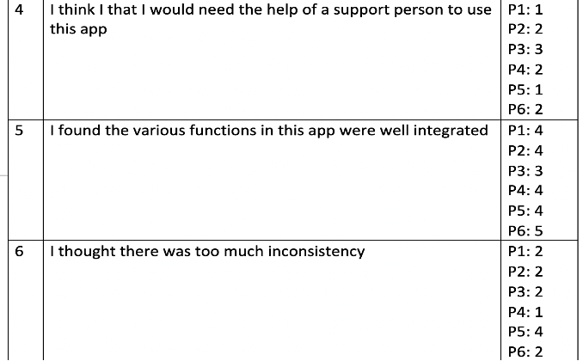
Usability test- results

Slide 11
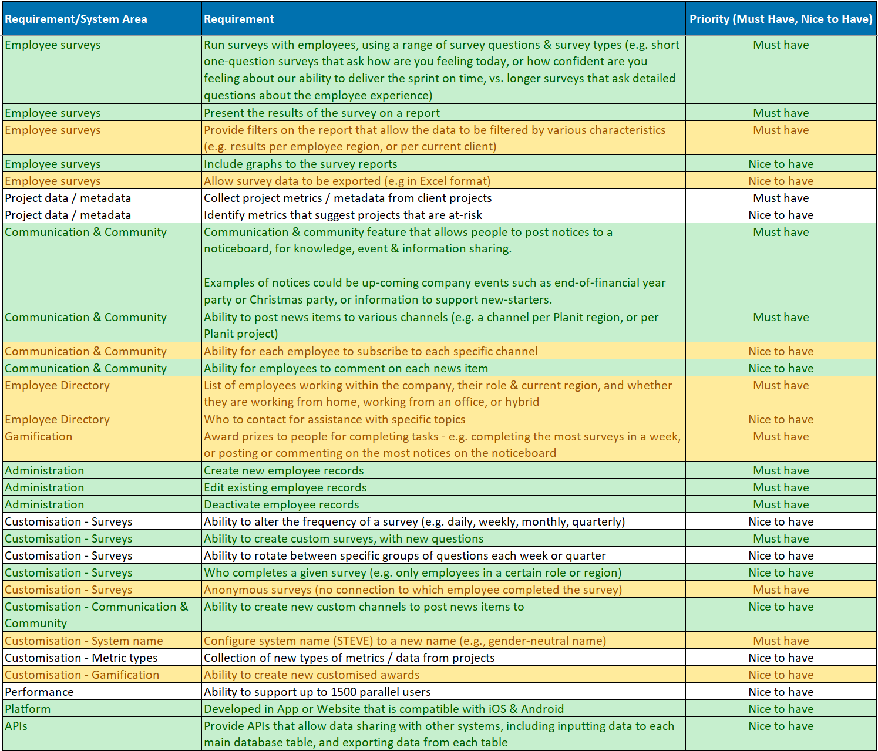
Reviewing Requirements

Slide 12
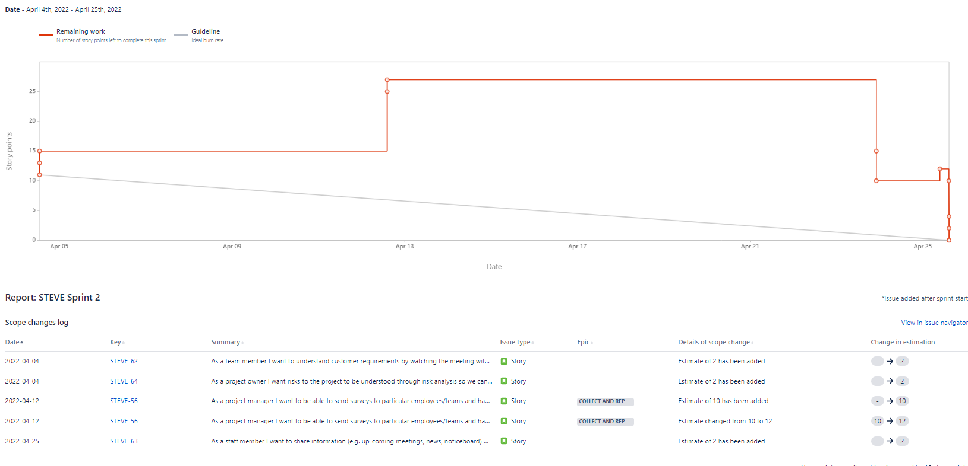
Agile – First Sprint

Slide 13
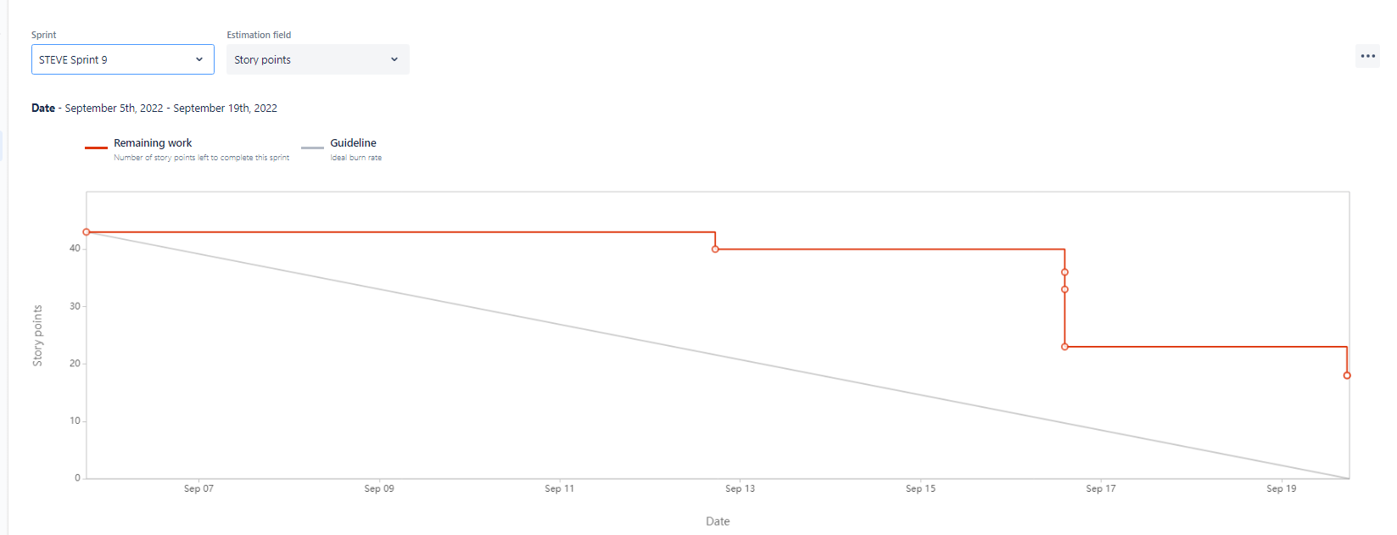
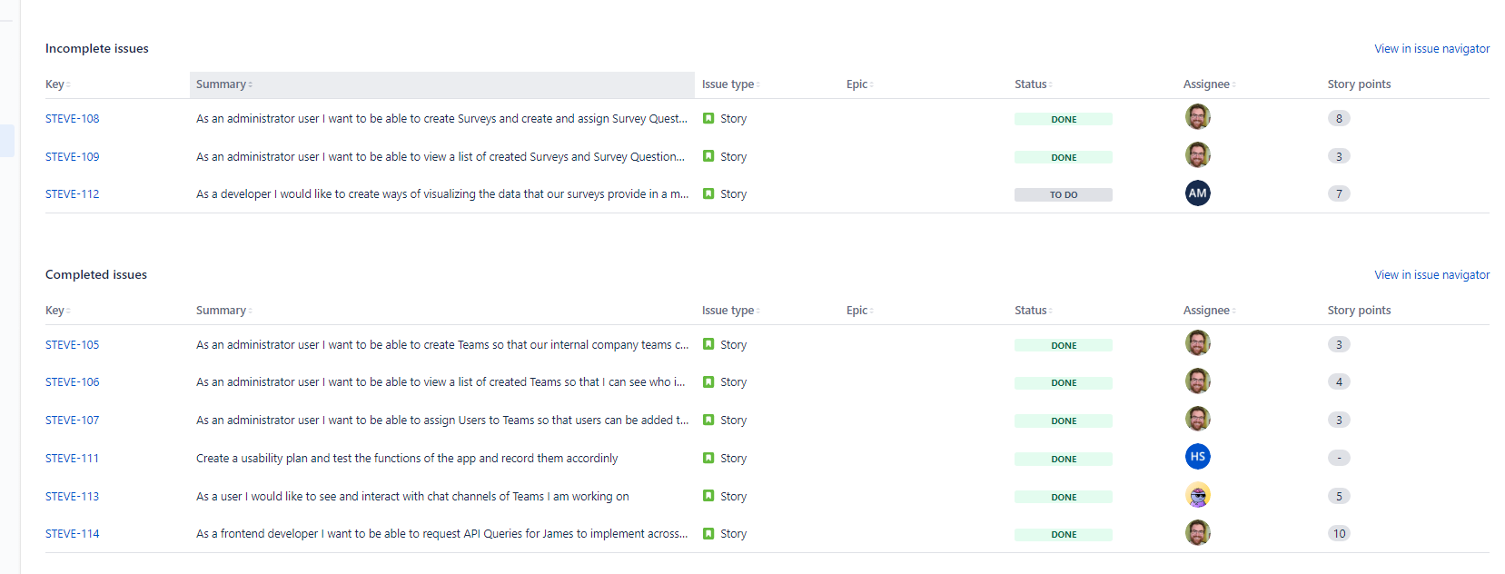
Agile – Sprint 9

Slide 14
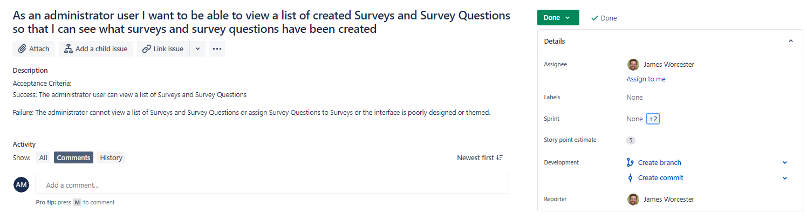
Agile – User Story Example

Slide 15
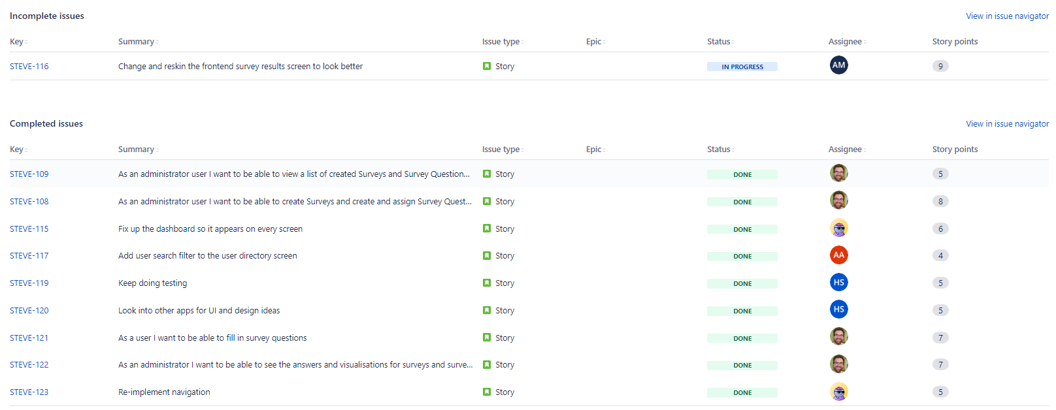
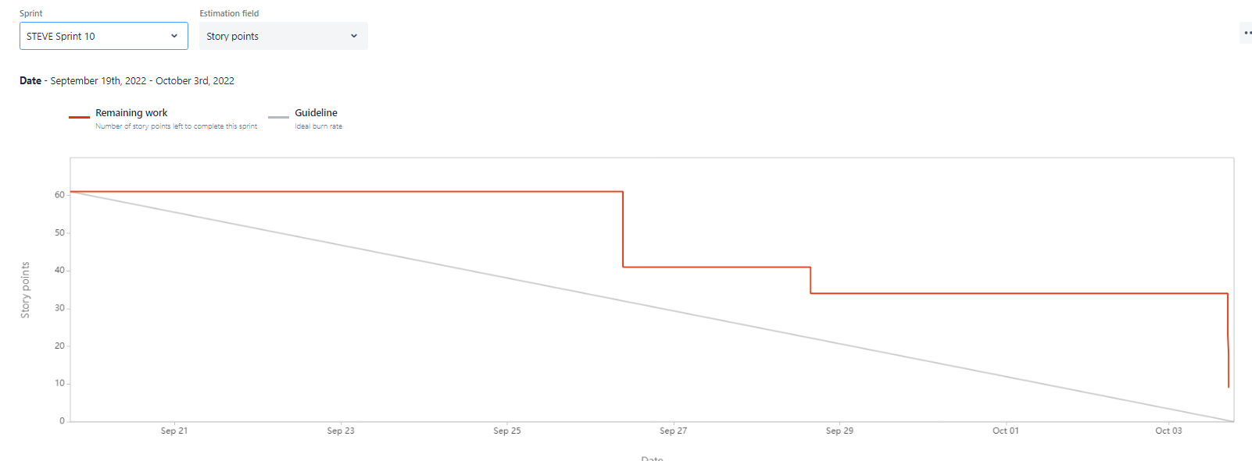
Agile – Sprint 10

Slide 16
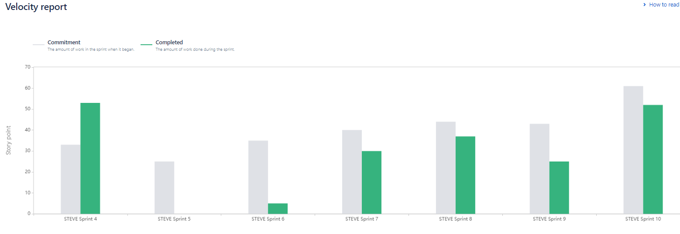
Agile – Velocity Report

Slide 17
Conclusion
Throughout the year the team has learnt a variety of new soft wares and learnt the importance of working as a team to achieve project goals
The team faced many struggles and setbacks that helped us learn the true reality of working an industry sized project.

Slide 18
Opening up to Questions and Feedback

Slide 19

Testing

Slide 20
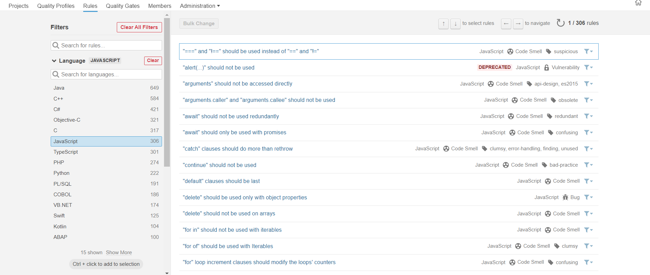
Testing Profile

Slide 21
Measures
Metric name | Value
Lines of Code | 814
Files | 41
Statements | 134
Functions | 42
Comment Lines | 172
Technical Debt | 1h 56min
Cyclomatic Complexity | 52
Cognitive Complexity | 19

Slide 22
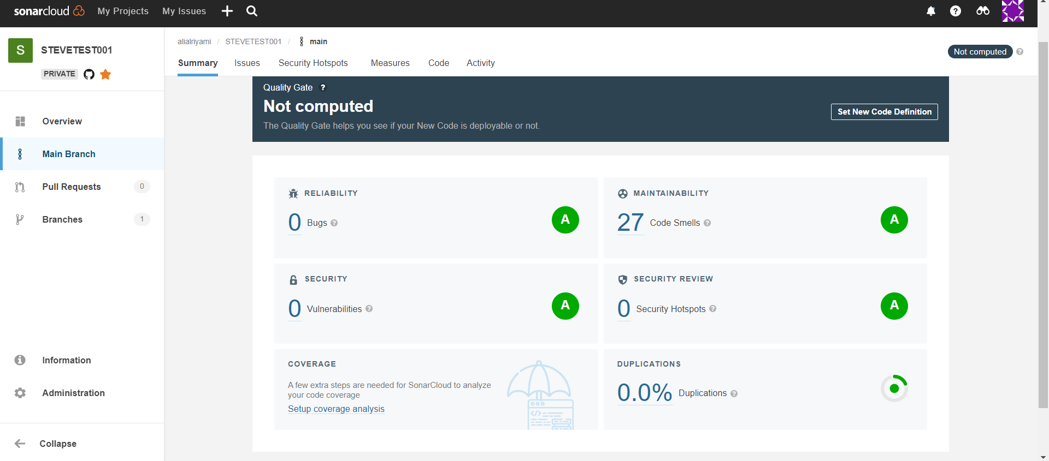
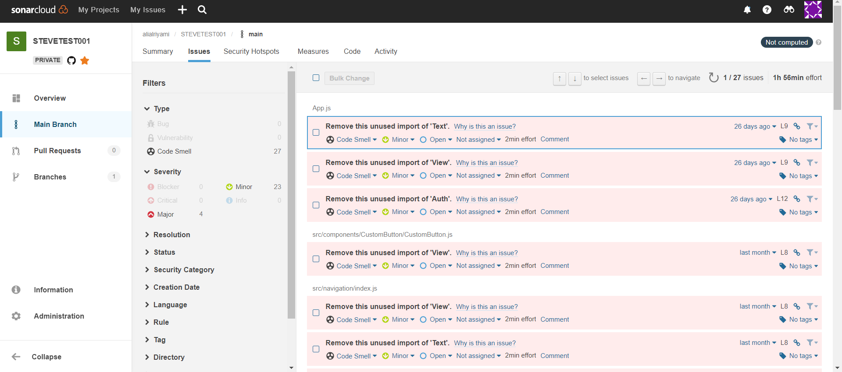
Results

Slide 23
Manual Testing
Potentially Dangerous Characters: The app is missing a security mechanism to prevent some characters from being inserted into the fields found in sign in/sign up pages.
Those characters include but is not limited to " ' , [ ] ( ) < > /....
Suggested Solution:
Use of "Whitelist" or also known as "Allowlist"
Use of REGEX

Slide 24
Reasons for Changing and Adapting
Allows for quick connectivity of the API & database
Flexibility in that connectivity
Easy monitoring metrics
Query-based API language
Simple yet powerful syntax
Front-end retrieves only the data it needs
Easy authentication and password management through Amazon Cognito
Integration with GraphQL
Potential for offline database synchronisation through Amazon DataStore

Slide 25
Reasons for Changing and Adapting
Serverless architecture
Scalable
Easily integrates with Amazon Appsync through a Data API

Slide 26



Past System Design
Client-Side
Server-Side
Cross-platform mobile app
Web Services
Web Application
REST APIs
Database
MySQL, PostSQL
NodeJS

Slide 27
Agile
Sprint 6 : It was not a good sprint because some reasons
Warmed-up sprint after a long break.
Fault time estimation of tasks so we did put more User Story than needed into our Backlog.
Real implementation takes more time because we all completely new to React Native and AWS.

Slide 28
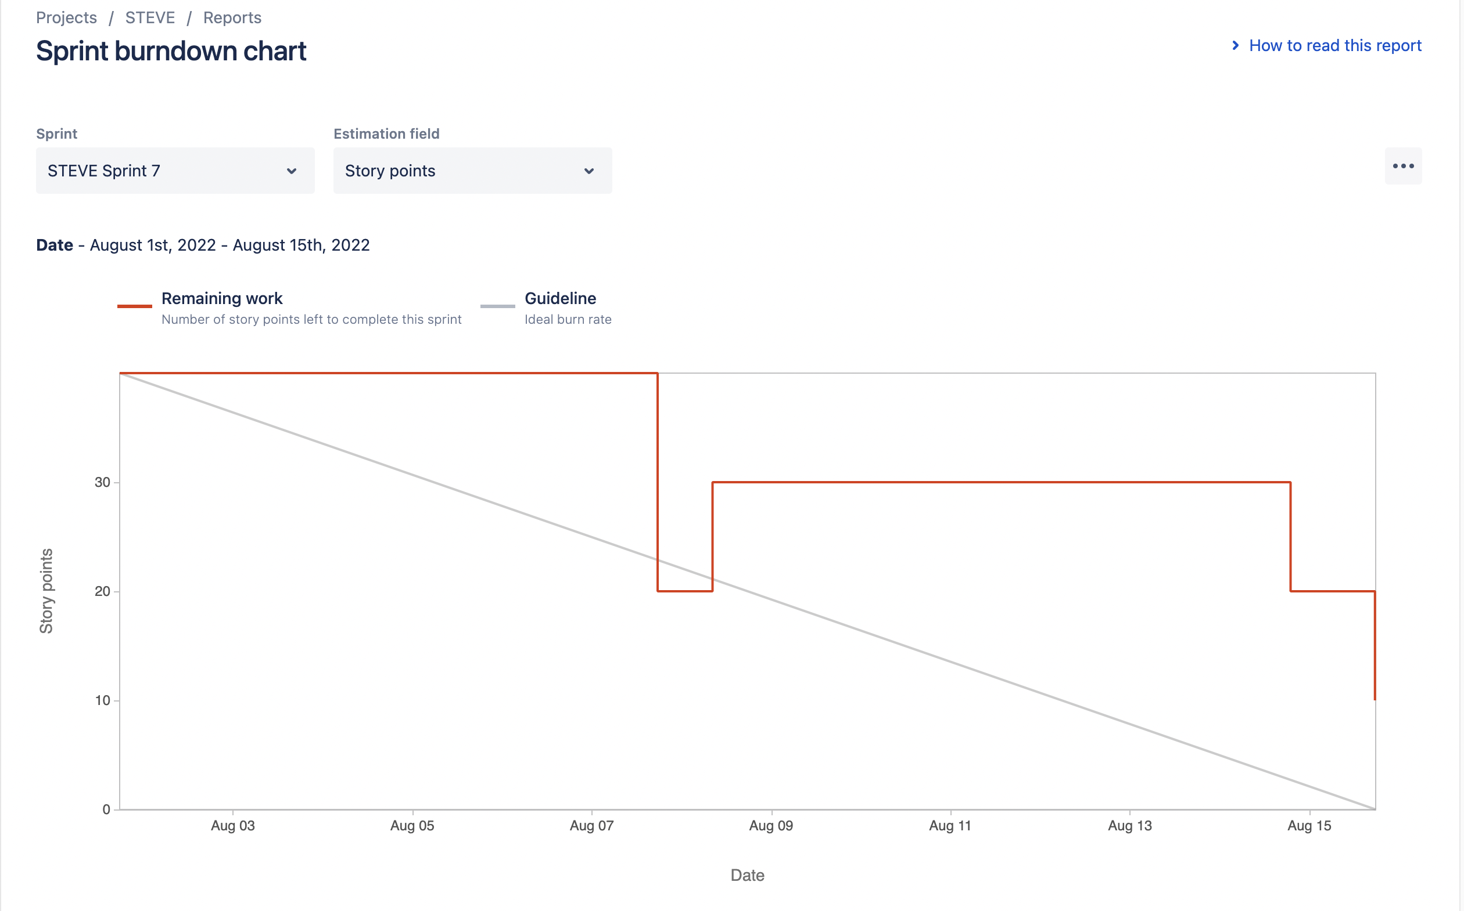
Agile
Sprint 7 : We made much more progress, so things look quite well!

Slide 29
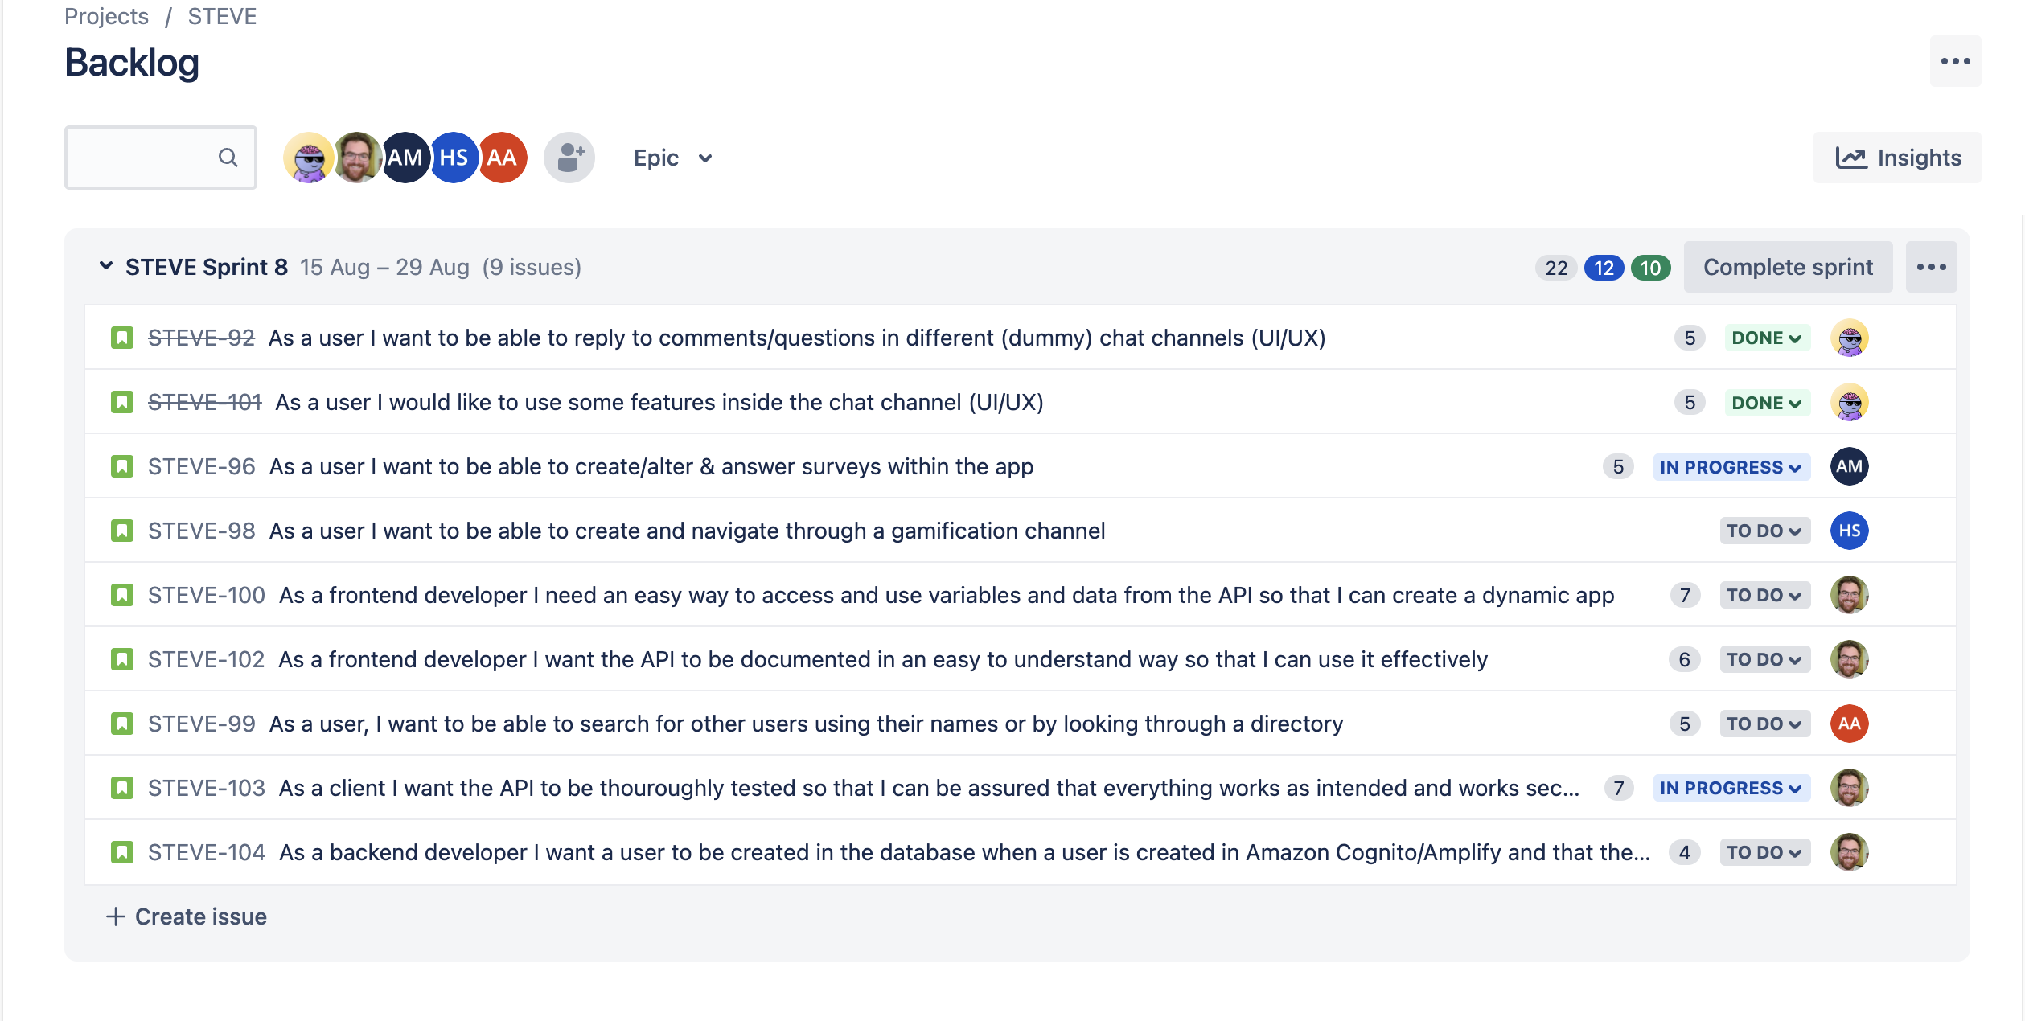
Agile

Slide 30

Staff Engagement Visualisation Experience
By Team Freeware

Slide 31
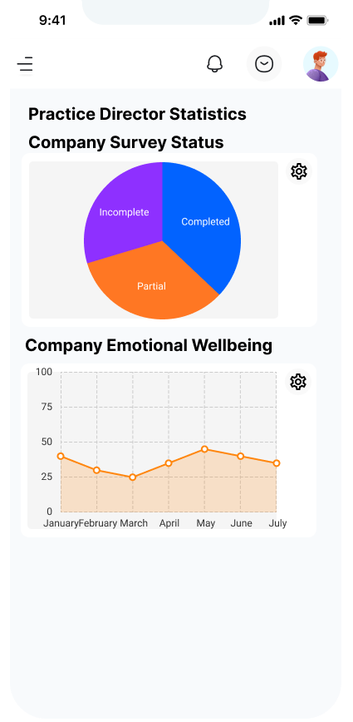
Our Guiding Principles
Staff Engagement
Visualisation
Experience
Fun
Easy to Use
Configurable
Visually Appealing and Engaging

Slide 32
Presentation Purpose
Why?
To show our current progress, design and interpretation of requirements
How?
Showcasing a current System Overview using Evolutionary Prototyping
Walking through our Sprint plan, Sprint backlog and implementation
Analysing and showing User Stories from our last Sprint
Presenting a Structural View of the Problem Domain in UML
Reflecting on areas for improvement
Opening up to Questions and Feedback
Identifying Risks and Risk Management
Explaining the System Architecture

Slide 33
Presentation Purpose
Why?
To show progress and development since our last presentation
How?
Analysing and showing User Stories from our recent sprints
Presenting a Structural View of the Problem Domain through detailed documentation and diagrams
Reflecting on areas for team and individual improvement using metrics
Opening up to Questions and Feedback
Presenting a System Overview with significant depth
To communicate and clarify our understanding of the problem domain
Showcasing our Sprint Plan, Sprint Backlog and Implementation since our last presentation
Explain System Architecture and our reasoning behind architectural choices
Showing a detailed Database Design with complete system connectivity across the entire problem domain
Presenting additional User Interface designs since our last presentation
Exploring Testing Methodologies, Approaches and Scenarios for testing throughout development

Slide 34
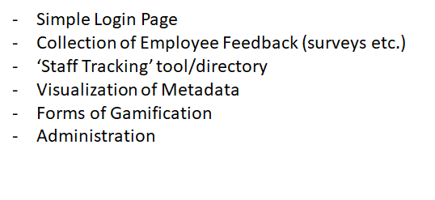
System Overview

Slide 35
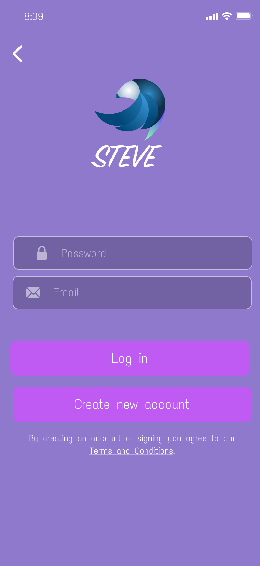
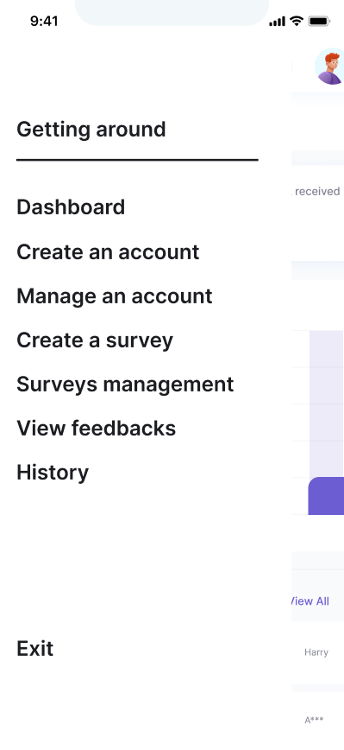
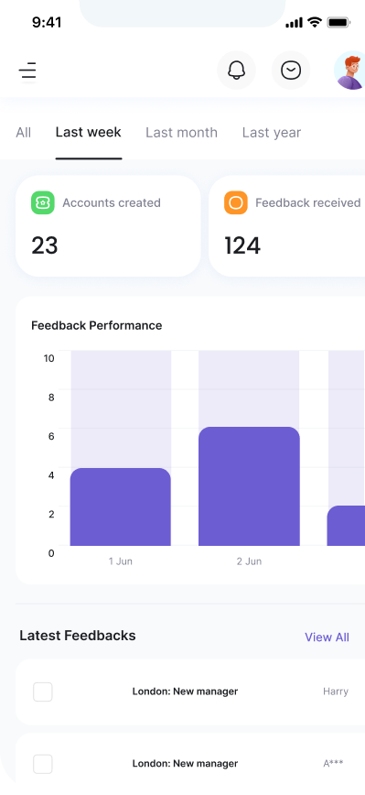
System Overview

Slide 36
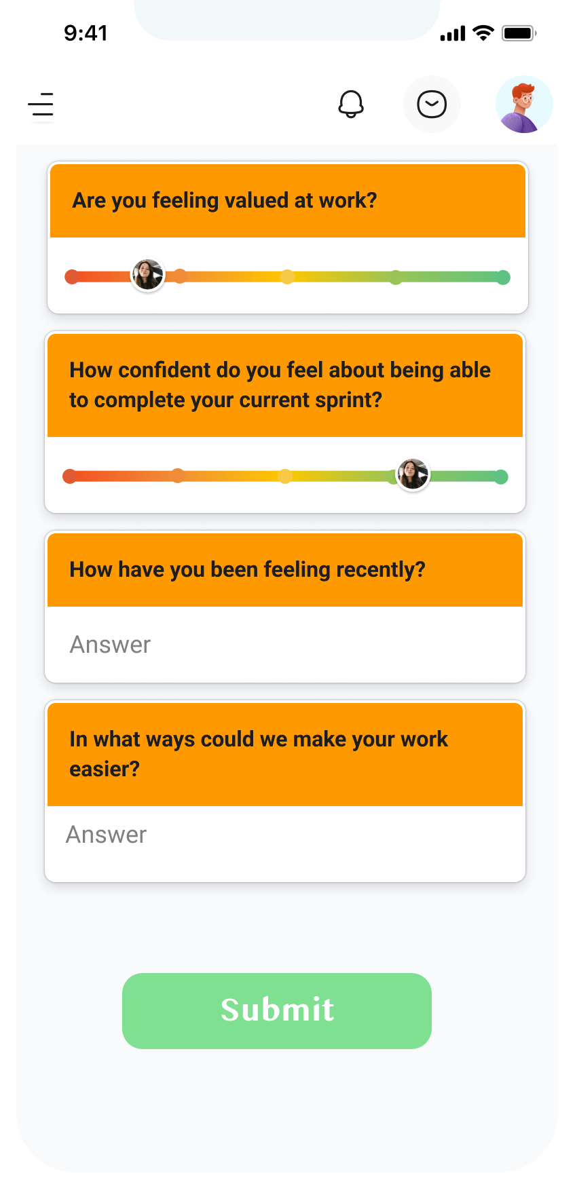
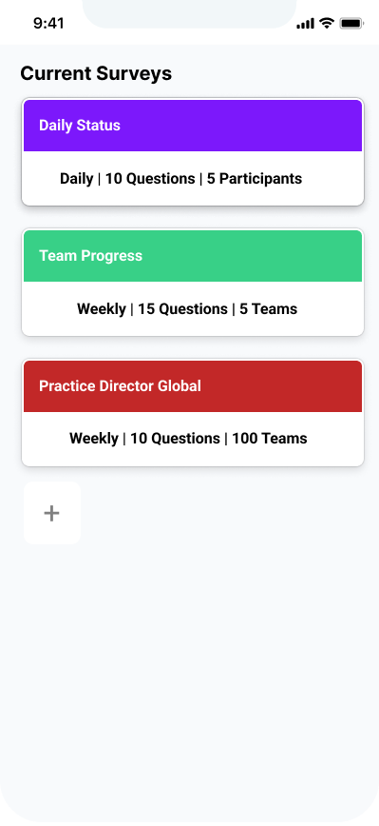
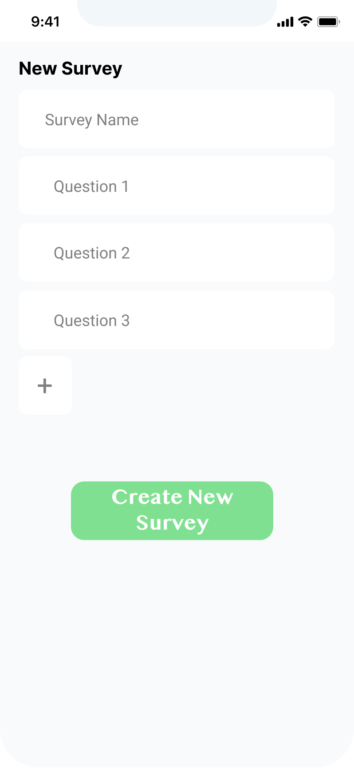
System Overview

Slide 37
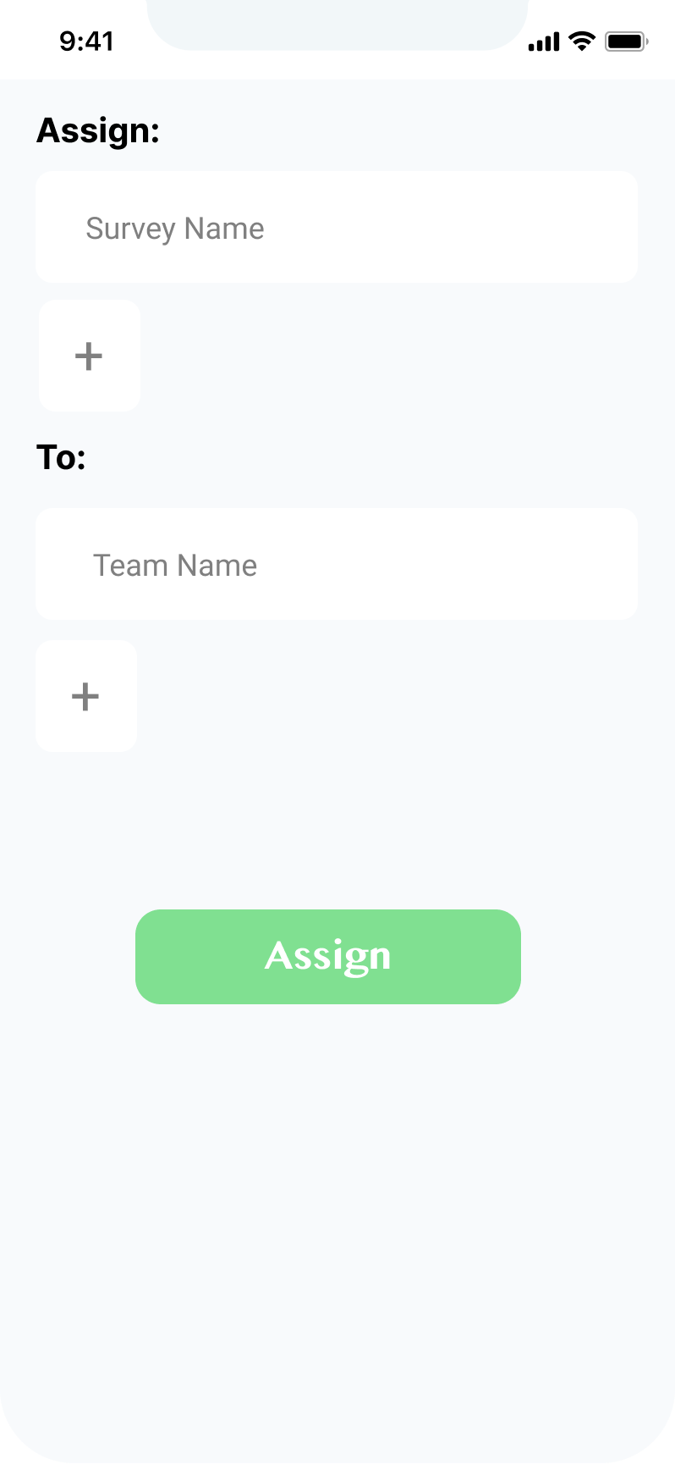
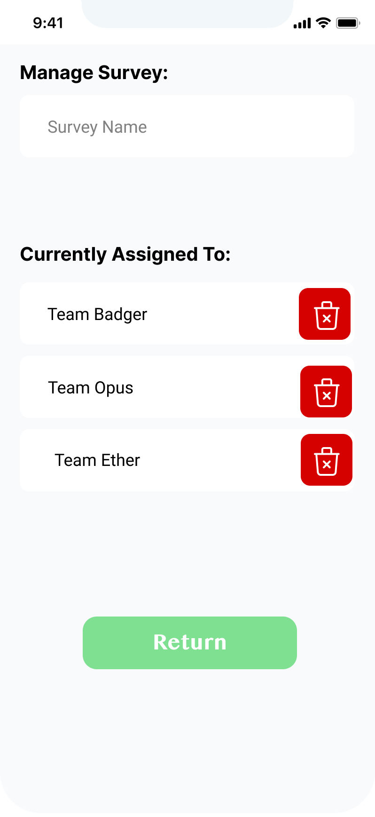
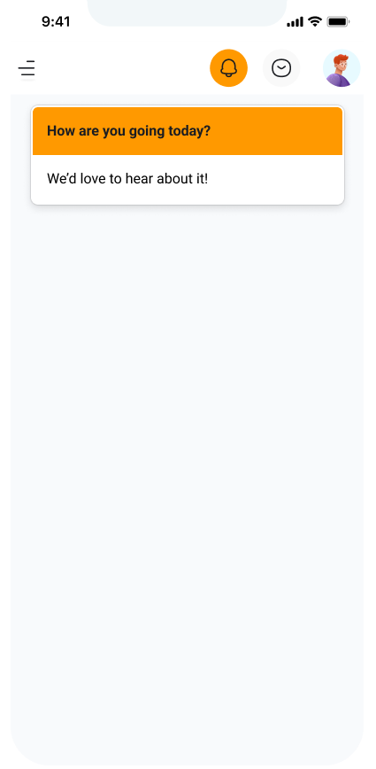
System Overview

Slide 38
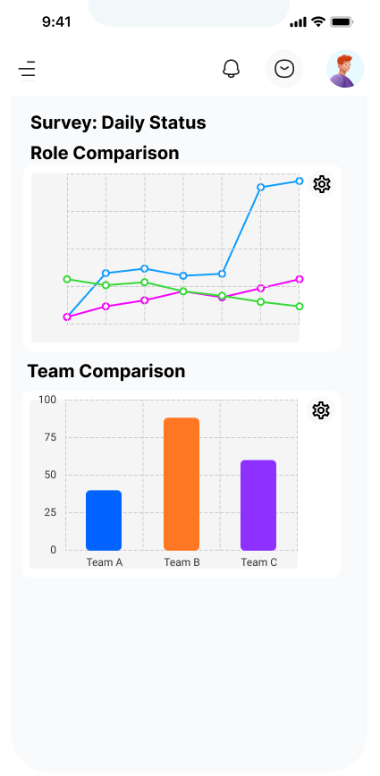
System Overview

Slide 39
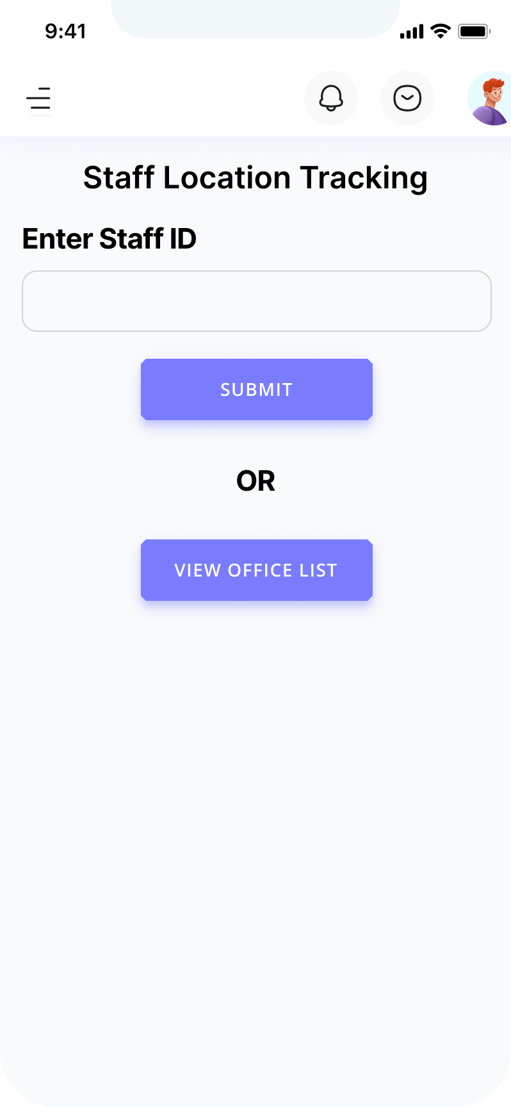
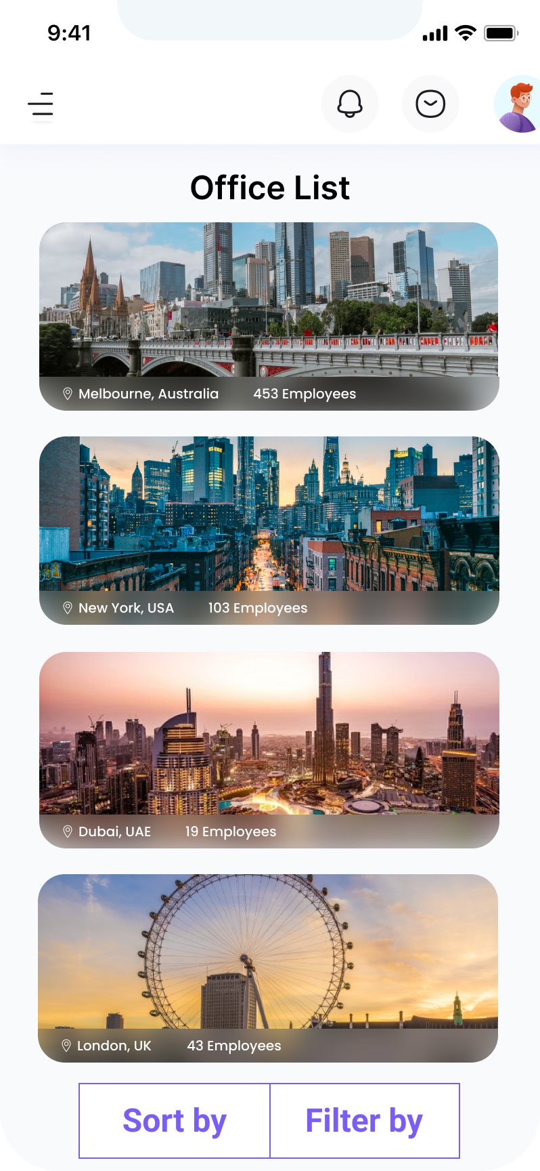
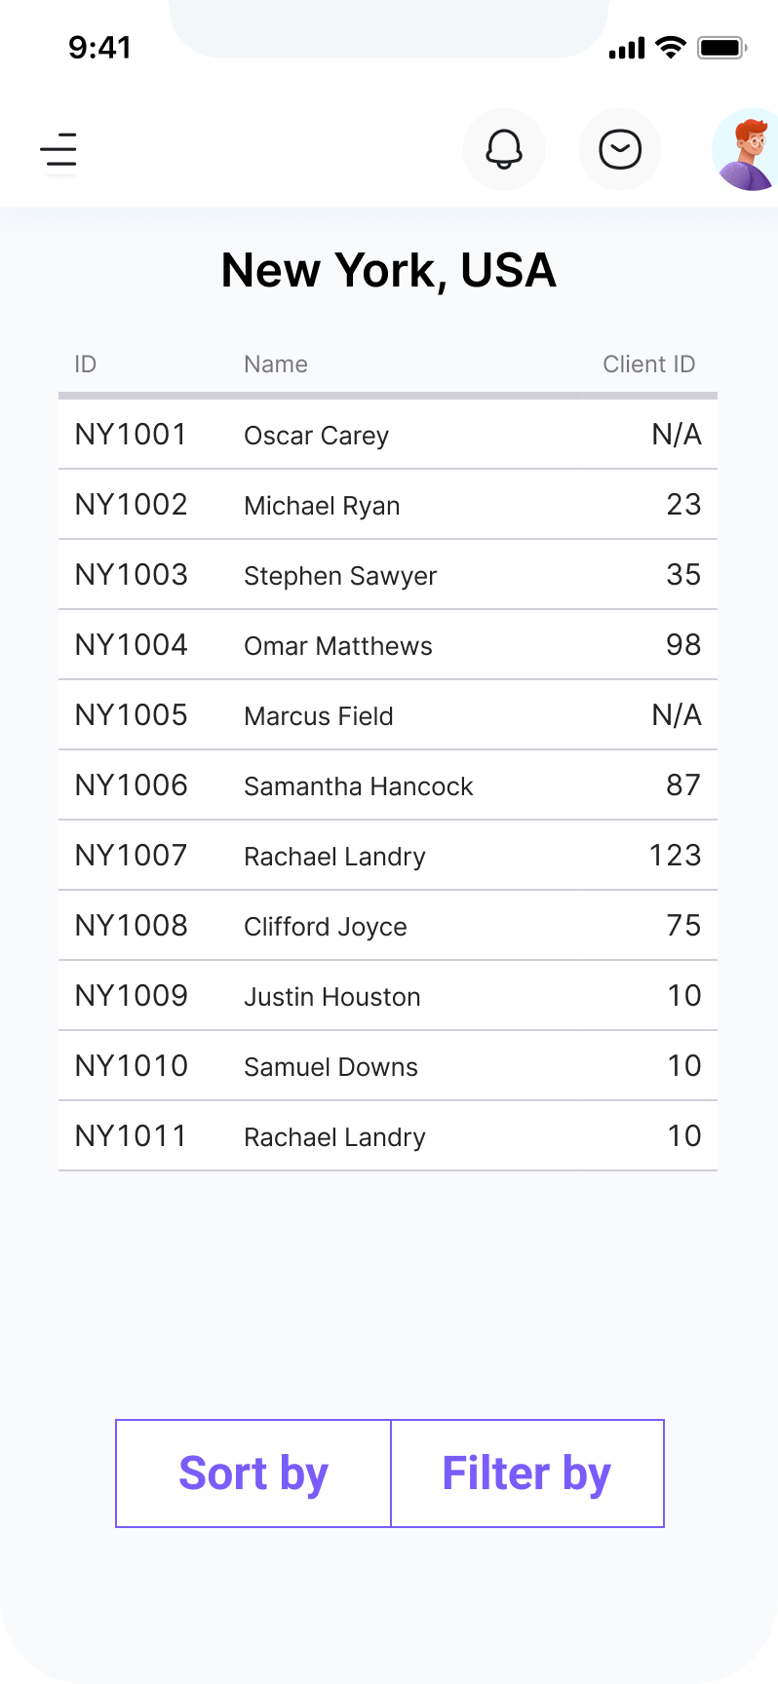
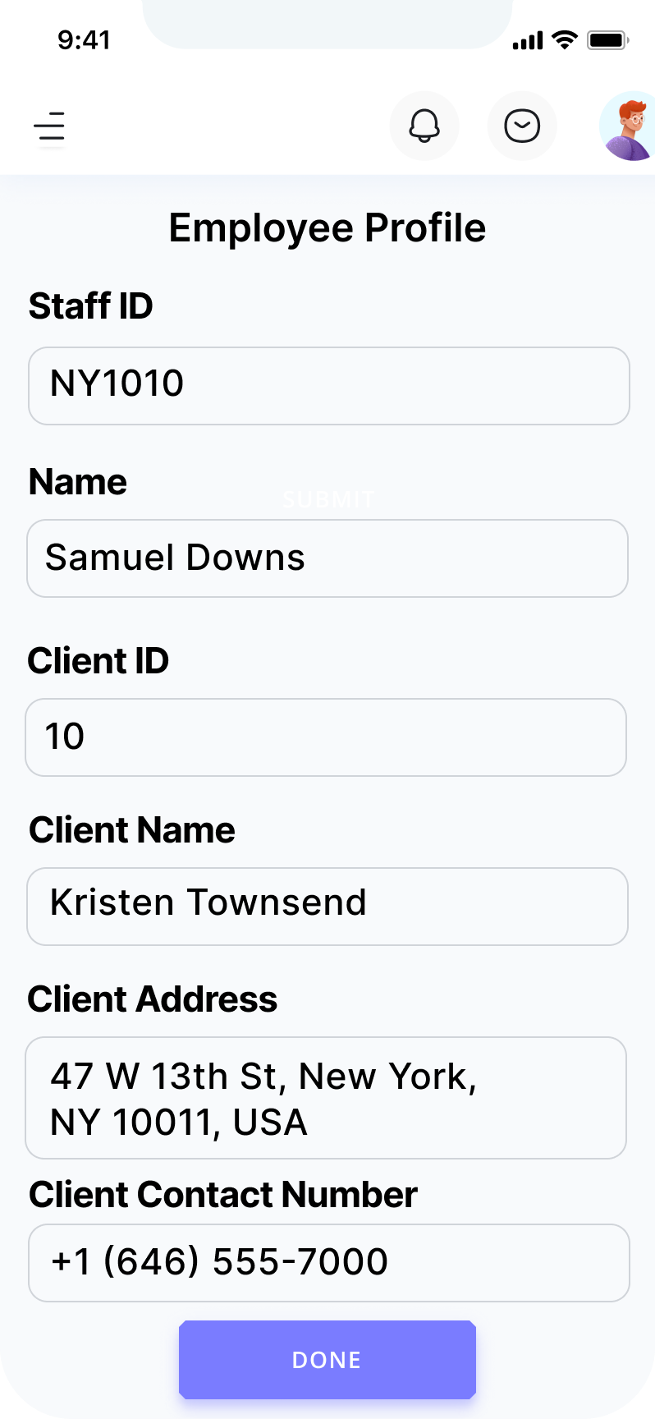
System Overview
User Story -
As a manager I want a staff location tracking feature so that I can track where staff are.
- 9 Story Points

Slide 40
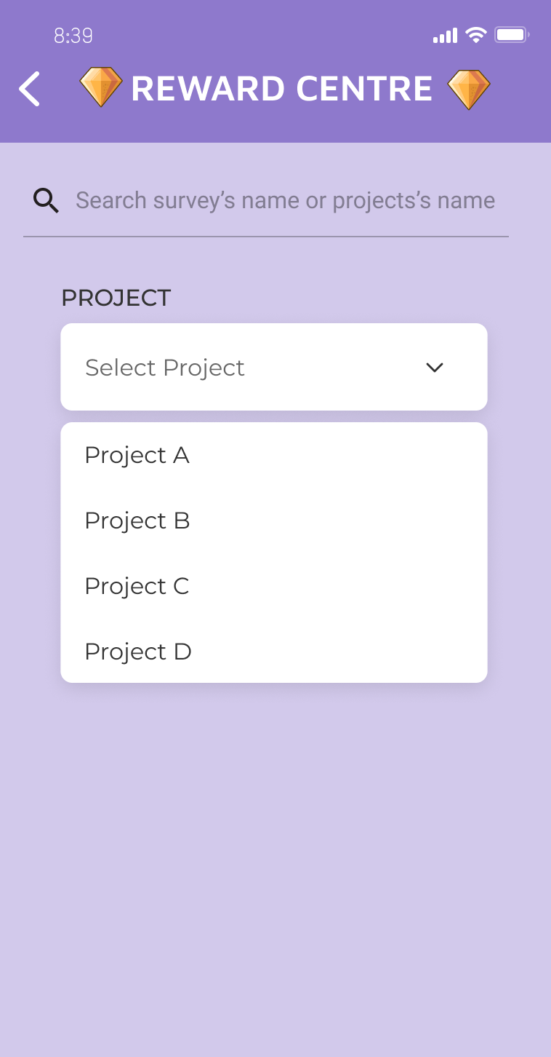
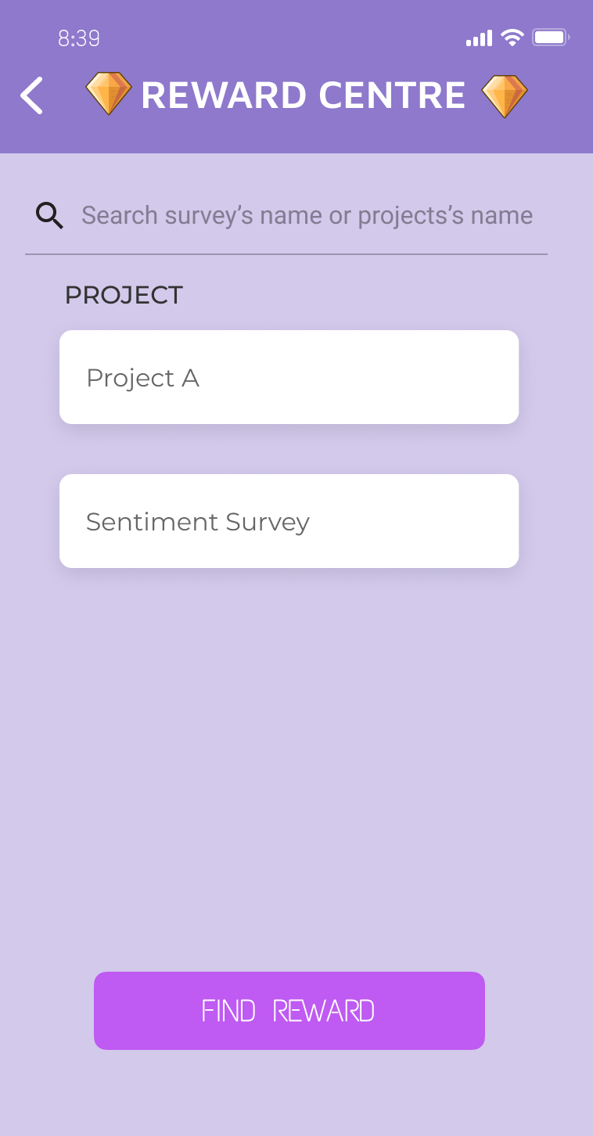
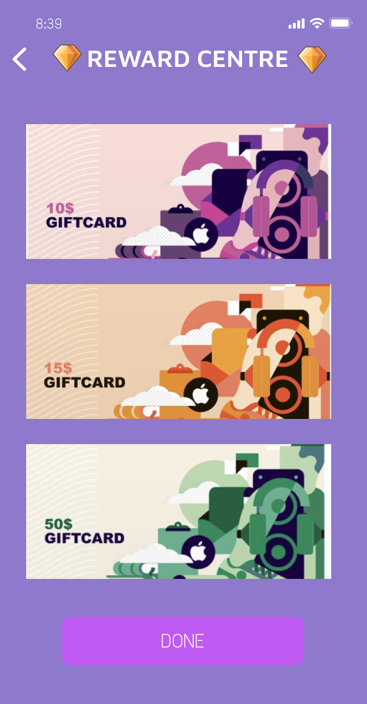
System Overview
User Story -
As a manager I want to gamify the application and be able to provide prizes to employees and teams so that I can keep them motivated and engaged
- 10 Story Points

Slide 41
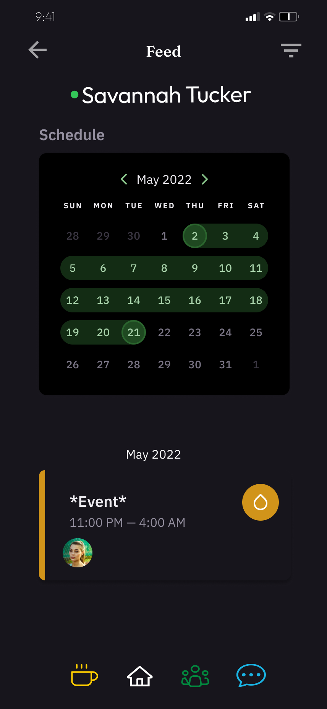
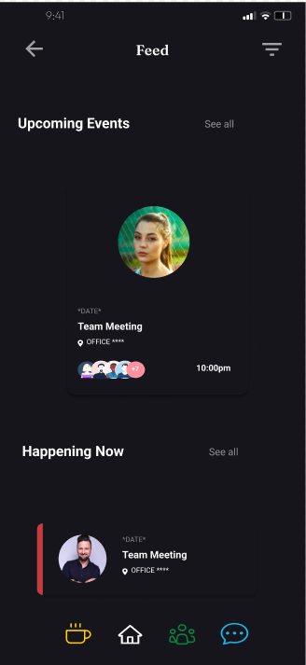
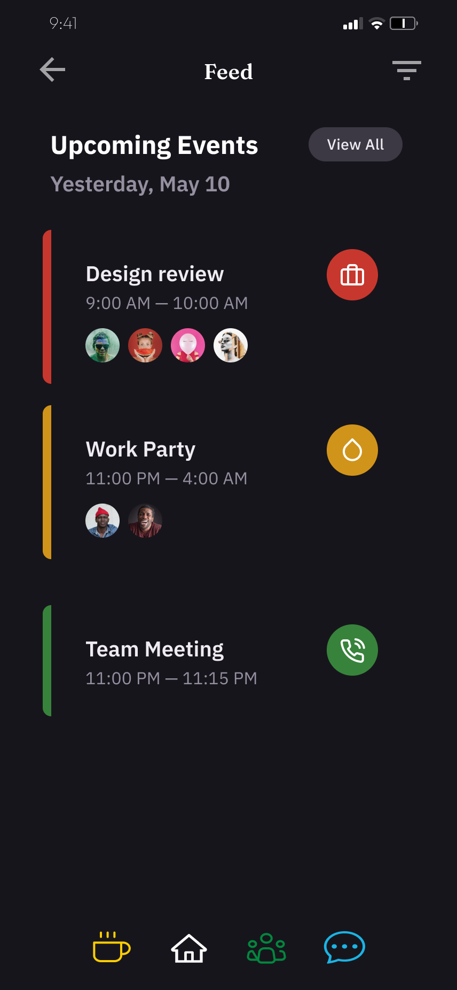
System Overview
User Story -
As a staff member I want to share information (e.g., up-coming meetings, news, noticeboard) between other staff with the ability to subscribe with notifications.
- 5 Story Points

Slide 42
System Architecture
System Architecture
Client-Side
Server-Side
Cross-platform mobile app
Web Services
Web Application
REST APIs
Database
MySQL, PostSQL
NodeJS

Slide 43
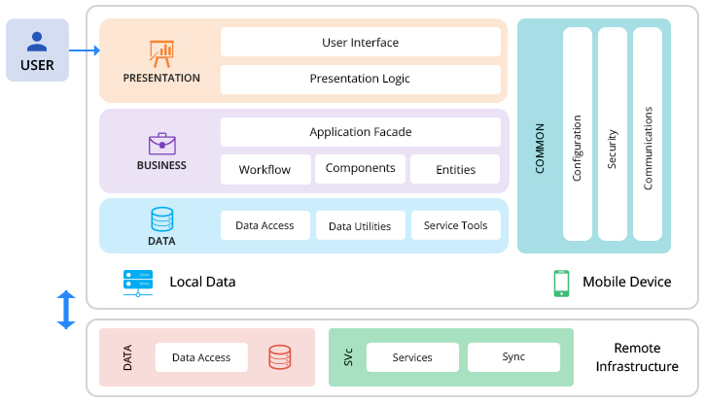
System Architecture
High level architecture diagram

Slide 44
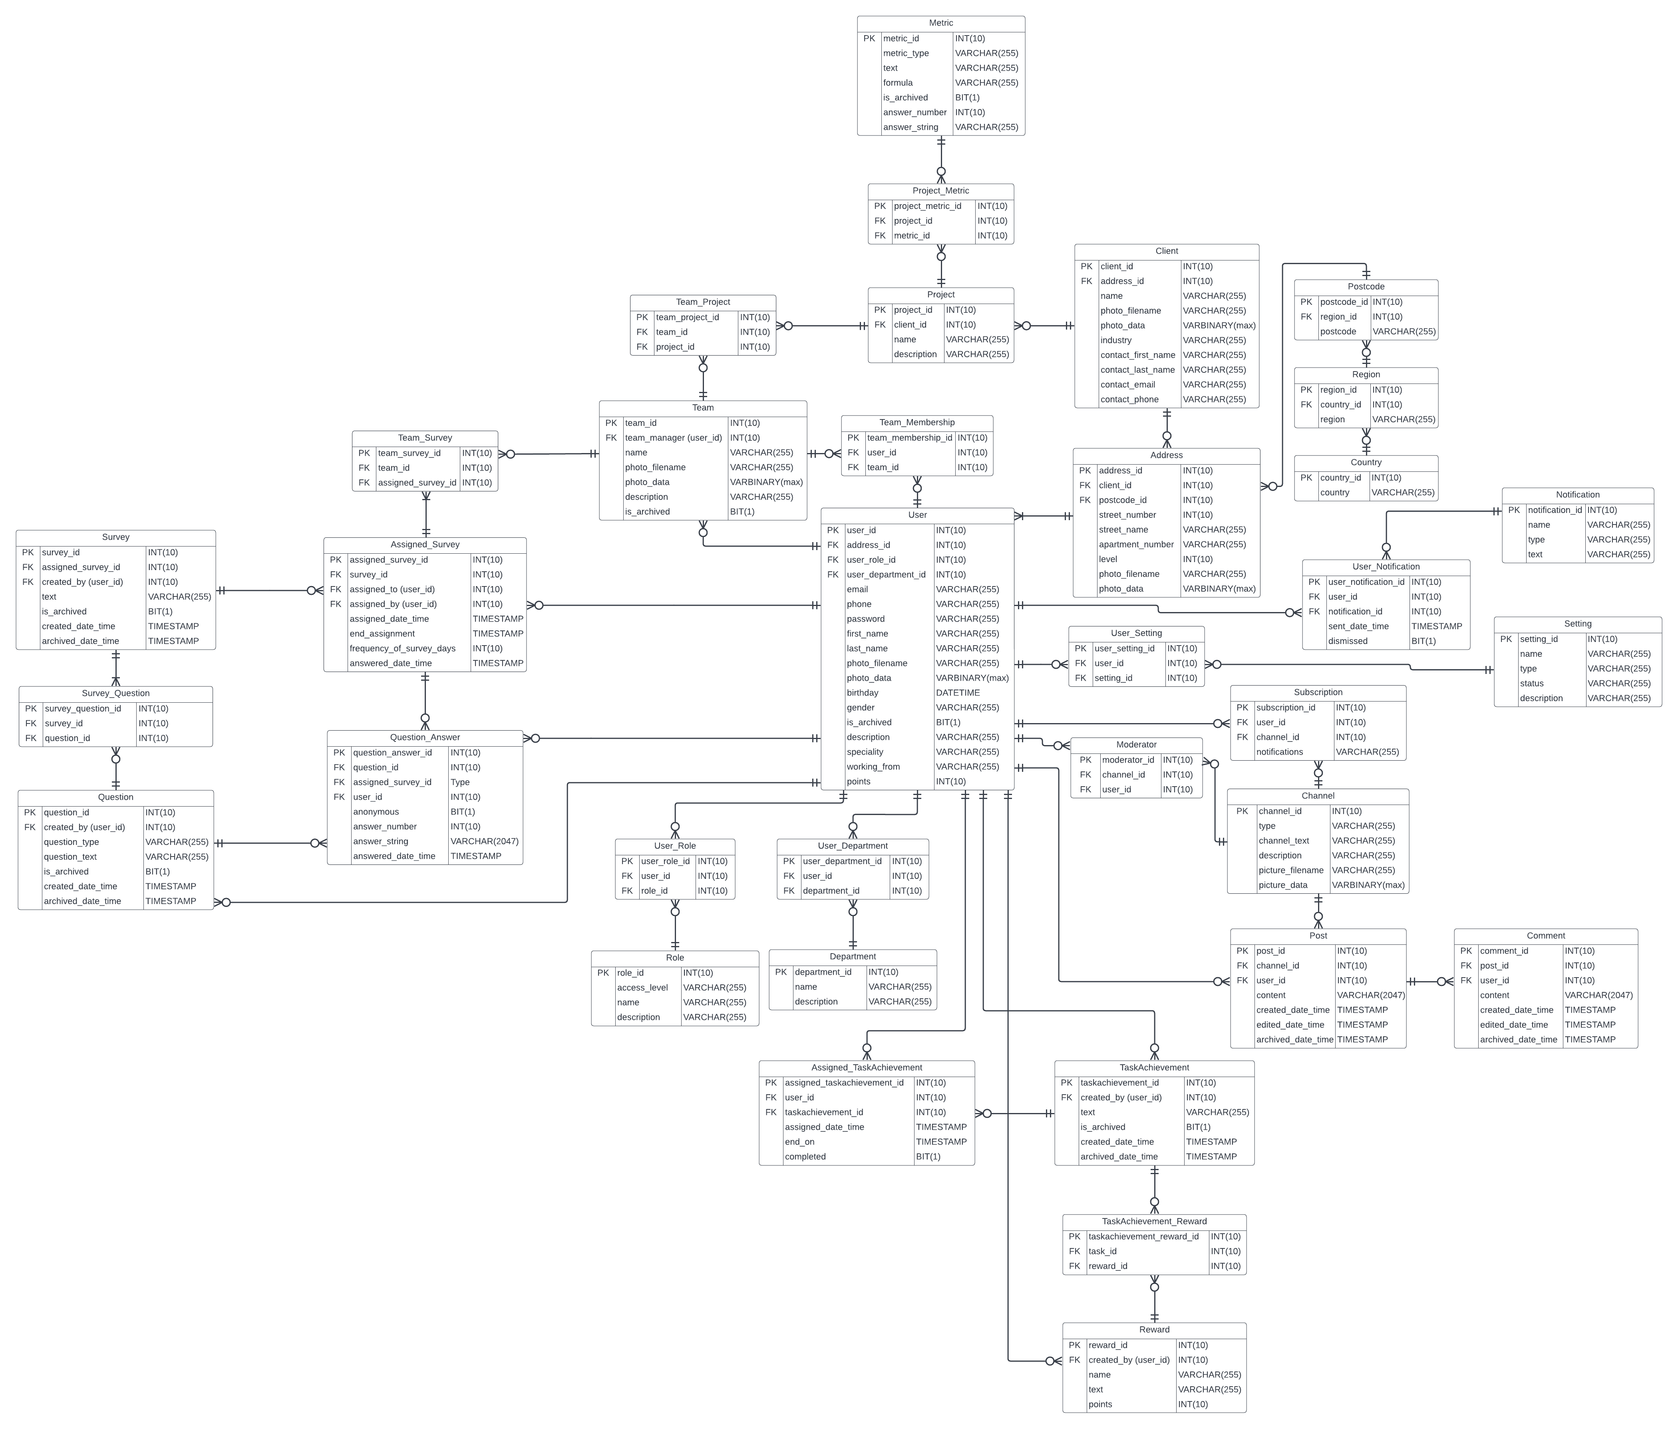
Database Structure & Connectivity

Slide 45

Object Dictionary

Slide 46

Sprint Planning

Slide 47


Sprint Planning- burndown chart

Slide 48

Sprint Planning – velocity report

Slide 49

User Story 1

Slide 50


User Story 1

Slide 51
User Story 1
Acceptance Criteria | Failures
Survey results are visualized | Surveys are not properly visualized
Manager can send specific survey's | Manager is not able to send surveys
Individual, Team, Company processes are tracked | Processes are not properly tracked

Slide 52
User Story 2
"As a manager, I want a staff location tracking feature so that I can track where staff are".
Story points: 7
Acceptance Criteria | Failures
Manager can view staff location | Staff location are not displayed
When manager select a location, the manager sees the staff list | Selected location do not provide a staff list
Staff can view their client location | Client location are not displayed

Slide 53

Sprint Implementation
Cumulative Flow Diagram

Slide 54

Sprint Implementation
Current Sprint Burndown

Slide 55

Package Diagram

Slide 56

Sequence Diagram

Slide 57

Last Presentation: Structural View – Use Case Diagram

Slide 58

Last Presentation: Structural View - Domain Definition

Slide 59
Database Structure & Connectivity

Slide 60
Use Cases
Use Case 1: User Login
Use Case 2: User Logout
Use Case 3: User sends password reset request to their email
Use Case 4: User enters a new password
Use Case 5: User completes a survey
Use Case 6: User completes a survey question
Use Case 7: User searches through channels & noticeboards
Use Case 8: User views a channel/noticeboard
Use Case 9: User subscribes to a channel/noticeboard
Use Case 10: User unsubscribes from a channel/noticeboard
Use Case 11: User posts to a channel/noticeboard
Use Case 12: User edits one of their posts on a channel/noticeboard
Use Case 13: User comments on a post in a channel/noticeboard
Use Case 14: User edits one of their comments on a post in a channel/noticeboard
… Use Case 86: Administrator assigns an address to a client

Slide 61
User Story Definition
User Story ID | User Story | Acceptance Criteria | Story Points
AUS-01 | As a user I want to login and create into application so that I can use it properly for my jobs | The login interface pop up after running the app | 6
AUS-02 | As a user I want to create a new account so that I can log into my account | The create screen pop up after users click the Create account button | 6
AUS-03 | As a project manager I want to create and send surveys to any chosen teams or employees | The interface for creating survey appears include all the spaces for filling in | 12
AUS-04 | As a project manager I want to be able to track location of the team and staffs so I can manage better | The interface show up all the tracking functions and all the functions work smoothly | 9
AUS-05 | As a project manager I want to be able to reward the winner of the completed survey so staff will be engaged to work and finish tasks better | The Reward Center pops up and users can choose rewards or search project’s name or team’s name for. | 10
AUS-06 | As a user I want to have chat functions so everyone can discuss their feelings and projects they are doing together. | Everyone can send messages to each other through the app | 12

Slide 62
TESTING – User Story & Functional
User Story | Test ID | Acceptance Criteria | Description | Expected Output | Status
AUS-01 | AUS-01-T1 | The login interface pop up after running the app | Login function test | All the Login button can be seen clearly by users | Successful
 | AUS-01-T2 | Users will be logged in successfully after typing correct email address and password | Authentication test | The main dashboard will be displayed nicely after login completed | Successful
AUS-03 | AUS-03-T1 | The interface for creating survey appears include all the spaces for filling in | Create surveys functions test | Create survey Screen is displayed which show up all the fields to create a survey | Successful
 | AUS-03-T2 | The interface for completing and sending survey appears properly | Sending surveys functions test | After the process of creating surveys completed, the send button turns out and alert users when users click the send button | Successful

Slide 63

Risk Matrix

Slide 64
Risks
Risk | Likelihood | Impact
Losing a team member | Likely | Severe
A team member becomes very ill | Very Likely | Severe
The time required to develop the software is underestimated | Likely | Severe
Developers struggle to learn new languages and frameworks | Likely | Severe
Software platforms fail to integrate as expected | Possible | Significant
Developers begin to feel overwhelmed | Likely | Severe
Miscommunication/Lack of communication | Likely | Severe
Developers fail to meet Sprint targets | Likely | Significant
Developers fail to utilise the winter break | Likely | Significant

Slide 65
Areas for Improvement
Communication Between Team Members/Everyone should know what their assigned tasks are.
Improving Future Sprints
'Better'/more concise user stories that can be split into multiple parts
Learning Programming Languages
More research into JavaScript as we will be using 'React Native'

Slide 66
Agile Maturity Model ???

Slide 67

Team Effectiveness Questionnaire

Slide 68

Sample

Slide 69
Team Effectiveness Dimensions
3.85/5
Purpose and Goals
3.85/5
Roles
3.75/5
Team Processes
3.92/5
Team Relationships
4.42/5
Problem Solving
4.28/5
Passion and Commitment
3.96/5
Skills and Learning

Slide 70

Team Effectiveness Score
80%

Slide 71
Areas for Improvement
Team Processes
Purpose and Goals
Roles

Slide 72
Conclusion
To conclude:
The team has proven their ability to constantly learn and adapt to new changes and learn new softwares/systems that may help improve the project
The team was able to do some testing and figure out some softwares that we will use for the final product
In the next presentation:
Complete set of sprints is to be done
Show some protoypes
The team will be ready to implement their plan into a product

Slide 73
Opening up to Questions and Feedback
Do you have any questions, feedback or areas you think we could improve?

